Slide 1

Windows PowerShell
System administration and automation in a Windows environment
- Remoting -
Karin De Maertelaere, Jochen Mariën

Slide 2
Remoting
Classic remoting
And why we don’t like it anymore
Windows PowerShell remoting
…

Slide 3
Classic remoting
$cred = Get-Credential
Get-WmiObject win32_diskdrive `
–computername DC01 -credential $cred
Used remote technology?
Is defined by the author of the cmdlet
RPC – Remote Procedure Call
DCOM – Distributed Component Object Modeling
Which cmdlets support this?
Parameter –Computername: 24 cmdlets
Authentication as current user
Or using parameter –Credential: 13 of which can use a credential
Error messages produced by underlying remoting technology
Divers, misleading and inconsistent, because of different underlying technologies

Slide 4
Windows PowerShell remoting
Universal way of remoting for all cmdlets
CLIENT
Caller
#sessions: unlimited
SERVER
Remote system
#sessions: 5
Using WinRM service
In a new (hidden) session
Notes:
#sessies aan client kant: onbeperkt. De enige limiet die er is zijn de resources die voorhanden zijn.
Throttlelimit =32 bepaalt het aantal sessies die gelijktijdig worden bediend. Er is een queue van sessies. Dit houdt de bandbreedte binnen de perken

Slide 5
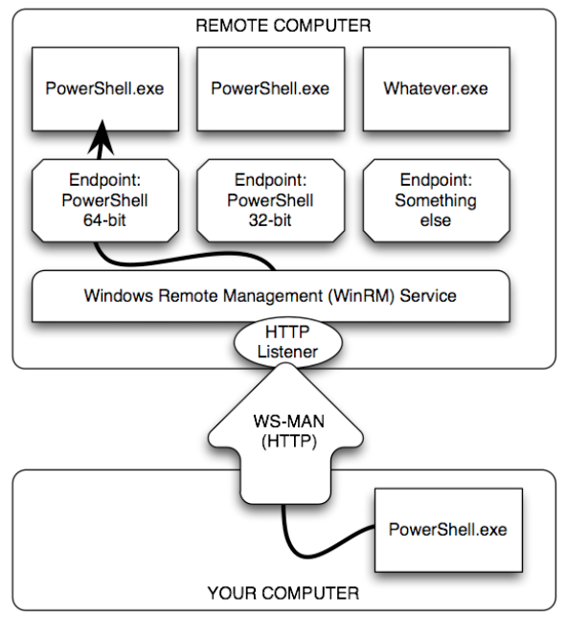
Notes:
The communication is done via the WSMan (Web Services management) protocol
The WSMan requests are handled by WinRM, the service.
The service listens to WSMan requests arriving over the network . The service listens on the http and https ports.
WSMan operates via http (port 5985) or https (port 5986)
A new hidden PowerShell session is initiated on the remote computer.
The output objects on the remote computer
=>conversion to XML
=> transport over http or https
=> conversion to objects again
= process of Serialize / Deserialize

Slide 6
What has to be installed
New computers (2012 R2, 2016)
Nothing, everything is installed and enabled by default
Older computers, in PS3.0
Microsoft .Net Framework 4.0 or later
Windows Remote Management 3.0
Very old computers, in PS2.0
Microsoft .Net FrameWork 2.0 or a later version
Windows Remote Management 2.0
Remote sessions between PS 3.0 en PS 2.0 clients are possible
But new features of 3.0 not available
Notes:
For test purposes : a remote session to your own machine
Connection standard via computername,
Or via IP address or DNS alias if the machine is included in list of trustedhosts
<#Remote problemen aanpakken
Virtuele netwerkadapters uitschakelen als ze ingesteld staan als openbaar (domain of private is wel toegelaten)
Access denied - PS in elevated mode starten
TrustedHosts * op beide machines instellen
Niet vergeten WinRM service herstarten-
Firewalls
"the RPC server is unavailable" zet firewall af op beide machines
zoek dan uit welke poorten gebruikt worden (135, 445) en voeg ze als exceptie toe
Normaal verzorgt Enable-PSRemoting de firewall settings

Slide 7
Improvements in PS 3.0
Error messages are much better
Sessions are less fragile
Can survive short network breaks
‘Disconnected’ sessions are possible
Use sessions responsibly
Session on remote pc still exists and consumes “resources”
You sign in on another machine with the same credentials
Using Get-PSSession you can see the disconnected sessions

Slide 8
Setup for Server
How to activate remoting?
Enable-PSRemoting (cmdlet)
WinRM quickconfig (application)
Via a group policy
Actions taken:
Start WinRM service
Configure listener
Enable Firewall exception
Firewall still has to be set to “Private” of “Domain” manually
Get-NetAdapter | Set-NetConnectionProfile -NetworkCategory Private

Slide 9
Setup for Server: the port number
Default port numbers are 5985 (HTTP) and 5986 (HTTPS) (both TCP)
You can change these…
Or with the navigation-model…
# which listener do we have?
Get-WSManInstance –ResourceURI winrm/config/listener -Enumerate
# set the port number
Set-WSManInstance –ResourceURI winrm/config/listener `
-ValueSet @{Port="22"} -SelectorSet @{Address='*';Transport='HTTP'}
cd WSMan:\localhost\Listener\
cd .\Listener_...
Set-Item Port -Value 22

Slide 10
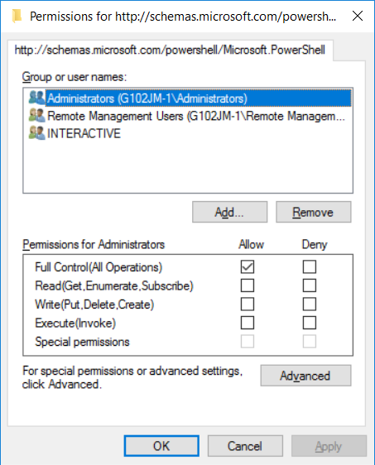
What users are allowed?
On the server, check
This shows the permissions of users to connect to this server
You can add or remove users or user groups
Set-PSSessionConfiguration Microsoft.PowerShell -ShowSecurityDescriptorUI

Slide 11
Setup for client
In domain
Requires only access to the remote system
In peer-to-peer network
Requires only the TrustedHosts setting
On the client, not on the server
You can only set the trustedhost-setting after running enable-psremoting
To secure the client-system, you may want to disable the remoting service afterwards
# Set one trusted host
Set-Item wsman:\localhost\client\trustedhosts 10.67.20.22 -force
# adding another trusted host
Set-Item wsman:\localhost\client\trustedhosts 10.67.128.254 -force -concatenate
# Using a wildcard
Set-Item wsman:\localhost\client\trustedhosts * -Force

Slide 12
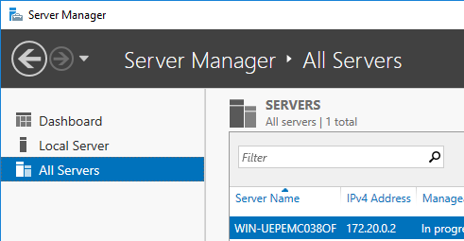
Setup for client
Fun fact! Managing a computer in a different domain (or not in a domain) from the server manager?
Use “*” in the trusted hosts!
Not the IP of the server, or part of the IP with a wildcard
Notes:
Also, run a console as a user from a different computer while not in a domain:
runas /user:domain/user /netonly mmc

Slide 13
What is possible when remoting?
All cmdlets and external programs that can be accessed via the paths behind the Path environment, can be used
There are issues with programs with a GUI
Try notepad.exe
You can’t rely on the profile settings of the remote pc
Remote $profile is empty, local profile has already been loaded
If you really want to use your profile:
invoke-command -session $s -filepath $profile

Slide 14
We’ll be using
$cred as a credential
Fill up $cred:
Do not store securestrings (passwords) in a file…
$pc as a computer
Computername (single label or FQDN)
IP-address
Can be an array of multiple computernames
$cred = Get-Credential -UserName "CD\Admin" -Message "Enter password"
$cred.GetNetworkCredential().Password

Slide 15
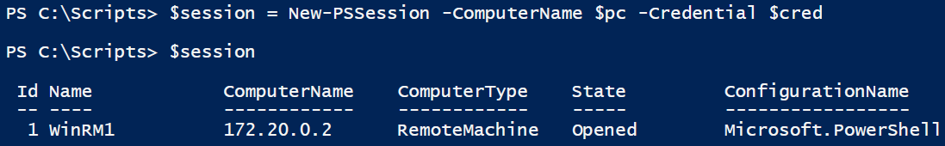

Create a permanent session
Kind of like RDP, but with PowerShell
You can enter the session, and execute commands…
And exit back to the host without closing the session

Slide 16
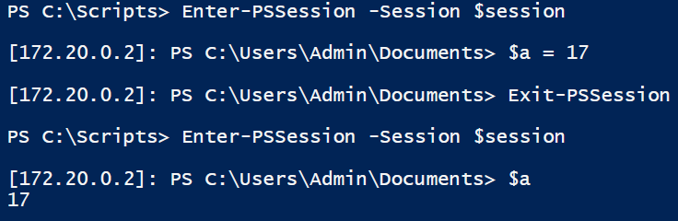
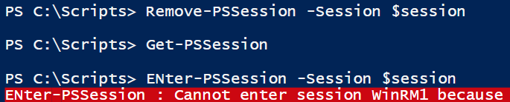
Permanent session
A session never dies:
Unless you kill it:

Slide 17
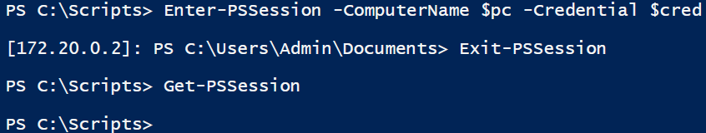
Permanent session
You can create and enter a session in a single command:
After the Exit-PSSession, the session is removed automatically
This can be good or bad

Slide 18
Run one command
Invoke-Command runs one command on a remote computer
Can be run using a session or using a computername/credential
In a session: variables will remain
Using computername and credential: variables will be gone
Parameternames never have to be written in full, but should
Notes:
Invoke-Command -Session $s -ScriptBlock { $sumCPU = (Get-Process | Measure-Object -Sum CPU).sum }
Invoke-Command -Session $s -ScriptBlock { Write-Host $sumCPU -ForegroundColor Red -BackgroundColor Gray }
Invoke-Command -Computername $pc -Credential $cred -ScriptBlock { $sumCPU = (Get-Process | Measure-Object -Sum CPU).sum }
Invoke-Command -Computername $pc -Credential $cred -ScriptBlock { Write-Host $sumCPU -ForegroundColor Red -BackgroundColor Gray }

Slide 19
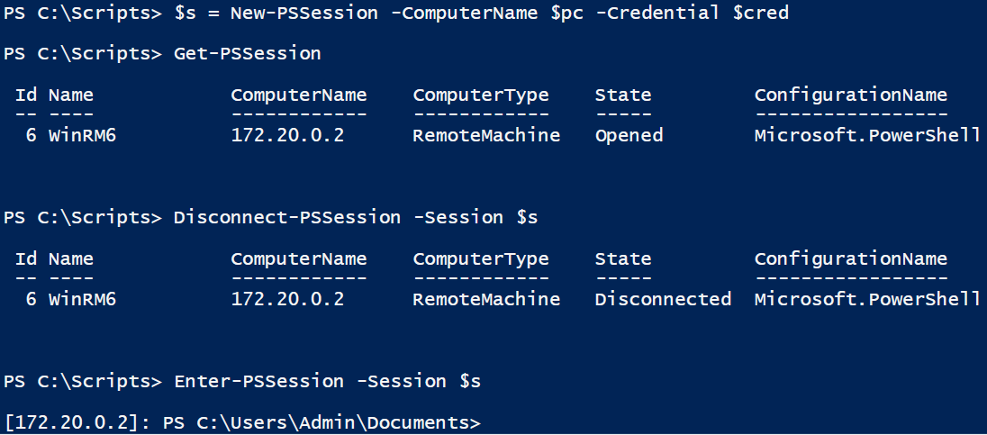
Disconnected session
‘In the zone’ on a remote PC, but have to go to a meeting?
Disconnect and reconnect during the meeting!
Everyone thinks you’ll be making notes, and congratulate you on your attentiveness to the meeting
Remember to regularly ask stuff like “Will this scale” and “Shouldn’t we take a step back?”
Notes:
https://docs.microsoft.com/en-us/powershell/module/microsoft.powershell.core/about/about_remote_disconnected_sessions?view=powershell-6

Slide 20
Disconnected session
A disconnected session can also be connected from a different computer
By anyone with the same credentials
But, it’s only possible when you started the session with “New-PSSession”, not when you created it with “Enter-PSSession”
You can also run a command that you know is going to take long in a disconnected session
Invoke-Command -ComputerName $pc -Credential $cred –InDisconnectedSession ` -ScriptBlock {
Foreach($i in (1..100)){
Write-Host $i
Start-Sleep -Seconds 2
}
}

Slide 21
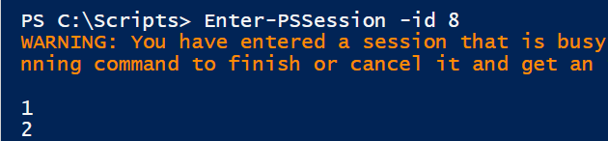

Disconnected session
The result:
View the output of the command?
Enter the session:
Receive the output to the host:
Get-PSSession -ID 8 | Connect-PSSession
Enter-PSSession -id 8

Slide 22
Who is connected
On a server, how do you see which users have a connection?
Or, check who is connected to the Wsman-port:
Kick a user?
Kill the wmsprovhost process
Session will show up as “Broken”
Get-Process wsmprovhost -IncludeUserName
Get-NetTCPConnection -LocalPort 5985

Slide 23
Using a local variable
Sending it along as a parameter
Or as a named (official) parameter
3.0 and later: use “using”
Invoke-Command -Session $s -ScriptBlock { Write-Host $args } -ArgumentList $var
Invoke-Command -Session $s -ArgumentList $var -ScriptBlock {
param($variable)
Write-Host $variable
}
Invoke-Command -Session $s -ScriptBlock { Write-Host $using:var }
Notes:
https://docs.microsoft.com/en-us/powershell/module/microsoft.powershell.core/about/about_remote_variables?view=powershell-6

Slide 24
Using a CSV-file
The problem: You have CSV-file locally, but want to use it remotely
Solution 1: copy the file to the session, and execute it
$localPath = "c:\tmp\proc.csv"
Get-Process | Export-Csv $localPath
Import-Csv $localPath | Measure-Object -Sum CPU
$remotePath = "c:\temp\proc.csv"
Invoke-Command -Session $toDC -ScriptBlock { MD c:\temp }
Copy-Item -Path $localPath -Destination $remotePath -ToSession $toDC
# Enter the session, use the CSV
Enter-PSSession $toDC
$file = "c:\tmp\proc.csv"
Import-Csv $file | Measure-Object -Sum CPU

Slide 25
Using a CSV-file
Solution 2: Send the contents of the CSV as parameter
# Create the script
$script = "c:\tmp\script.ps1"
Set-Content -Value '$args | Measure-Object -Sum CPU' -Path $script
# Store content of CSV in variable, execute script remotely
$procs = Import-Csv $file
Invoke-Command -Session $toDC -FilePath $script -ArgumentList ($procs)

Slide 26
Local vs remote processing
# What you should do
Invoke-Command -ComputerName $pc `
-ScriptBlock {Get-EventLog Security -Newest 50 |
Where-Object {$_.EventID -eq 1212}}
# What you shouldn't do
Invoke-Command -ComputerName $pc `
-ScriptBlock {Get-EventLog Security -Newest 50} |
Where-Object {$_.EventID -eq 1212}
# What you should do
Invoke-Command -ComputerName $pc `
-ScriptBlock {Get-Process -Name Notepad | Stop-Process}
# What you shouldn't do
Invoke-Command -ComputerName $pc `
-ScriptBlock {Get-Process -Name Notepad} | Stop-Process

Slide 27
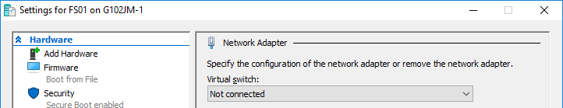

On Hyper-V: VMBus
Notes:
https://www.bytesizedalex.com/powershell-direct-over-hyper-v-vmbus/

